Slide 1
Lecture 11
Games
Yaohang Li
Department of Computer Science
ODU
Reading for This Class:
Chapter 7, Russell and Norvig

Slide 2
Review
Last Class
Constraint Satisfaction Problems
Backtracking Search
This Class
Games
Adversarial Search
Next Class
Pruning a Game Tree

Slide 3
Introduction to Adversarial Search
Multiagent environment
Unpredictability of other agent
Possible contingencies in problem solving
Adversarial search
Often known as games
Competitive environments
Agents’ goal are in conflict

Slide 4
Games vs. Search Problem
Unpredictable Opponent
Solution is contingency plan
Time limits
Unlikely to find goal
Must approximate
Plan of Attack
Algorithm for perfect play (J. von Neumann, 1944)
Finite horizon, approximate evaluation (C. Zuse, 1945; C. Shannon, 1950, A. Samuel, 1952-1957)
Pruning to reduce costs (J. McCarthy, 1956)
Search Problem
Single Player Game
Examples: Solitaire, Rubik’s cube

Slide 5
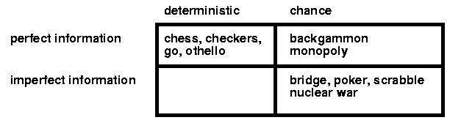
Category of Games
Information
Perfect Information
Fully-observable environment
Imperfect Information
Unclear environment
Uncertainty
Deterministic Games
The outcome is fixed
Non-Deterministic Games
The outcome is by chance

Slide 6
Zero-sum Games and Collaborate Games
Zero-sum Games
The winning and losing value at the end of the game are always equal and opposite
Collaborate Games
Agents are collaborating to achieve the highest score

Slide 7
Contingency Problem
uncertainty due to the moves and motivations of the opponent
tries to make the game as difficult as possible for the player
attempts to maximize its own, and thus minimize the player’s utility function value
different from contingency due to neutral factors, such as
chance
outside influence

Slide 8
Two-Person Game
games with two opposing players
often called MIN and MAX
usually MAX moves first, then they take turns
a sequence of two moves, one move by each player, is called a ply
MAX wants a strategy to find a winning state
no matter what MIN does
MIN does the same
or at least tries to prevent MAX from winning
Perfect information
both players know the full state of the environment
Partial information
one player only knows part of the environment
some aspects may be hidden from the opponent, or from both players

Slide 9
Define a Game Problem
The initial state
The board position
Identify the player to move
A successor function
Return a list of (move, state) pair
Indicating a legal move and the result state
A terminal test
Determines when the game is over
Terminal states
States where the game has ended
A utility function
A numeric value for the terminal states
Example
Tic-tact-toe, Chess (-1, 0, 1)
Go (+361, -361)

Slide 10
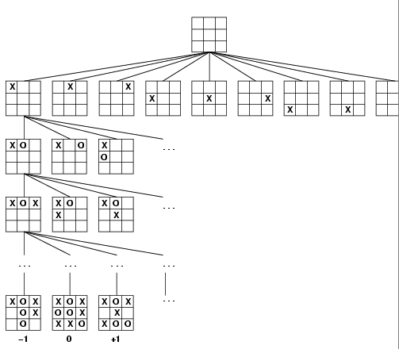
Game Tree
The initial state and the legal moves for each side define the game tree for the game
Example of Tic-Tac-Toe

Slide 11
Perfect Decisions
based on a rational (optimal) strategy for MAX
traverse all relevant parts of the search tree
this must include possible moves by MIN
identify a path that leads MAX to a winning state
often impractical
time and space limitations

Slide 12
MiniMax Strategy
optimal strategy for MAX
generate the whole game tree
calculate the value of each terminal state
based on the utility function
calculate the utilities of the higher-level nodes
starting from the leaf nodes up to the root
MAX selects the value with the highest node
MAX assumes that MIN in its move will select the node that minimizes the value

Slide 13
MiniMax Value
utility of being in the state that corresponds to a node
from MAX’s perspective: MAX tries to move to a state with the maximum value, MIN to one with the minimum
assumes that both players play optimally
function MiniMax-Value(state) returns a utility value
if Terminal-Test(state) then
return Utility(state)
else if Max is to move then
return the highest MiniMax-Value of Successors(state)
else
return the lowest MiniMax-Value of Successors(state)

Slide 14
MiniMax Example
4
7
9
6
9
8
8
5
6
7
5
2
3
2
5
4
9
3
terminal nodes: values calculated from the utility function

Slide 15
MiniMax Example
4
7
6
2
6
3
4
5
1
2
5
4
1
2
6
3
4
3
Min
4
7
9
6
9
8
8
5
6
7
5
2
3
2
5
4
9
3
other nodes: values calculated via minimax algorithm

Slide 16
MiniMax Example
7
6
5
5
6
4
Max
4
7
6
2
6
3
4
5
1
2
5
4
1
2
6
3
4
3
Min
4
7
9
6
9
8
8
5
6
7
5
2
3
2
5
4
9
3

Slide 17
MiniMax Example
5
3
4
Min
7
6
5
5
6
4
Max
4
7
6
2
6
3
4
5
1
2
5
4
1
2
6
3
4
3
Min
4
7
9
6
9
8
8
5
6
7
5
2
3
2
5
4
9
3

Slide 18
MiniMax Example
5
Max
5
3
4
Min
7
6
5
5
6
4
Max
4
7
6
2
6
3
4
5
1
2
5
4
1
2
6
3
4
3
Min
4
7
9
6
9
8
8
5
6
7
5
2
3
2
5
4
9
3

Slide 19
MiniMax Example
5
Max
5
3
4
Min
7
6
5
5
6
4
Max
4
7
6
2
6
3
4
5
1
2
5
4
1
2
6
3
4
3
Min
4
7
9
6
9
8
8
5
6
7
5
2
3
2
5
4
9
3
moves by Max and countermoves by Min

Slide 20
Minimax Algorithm
function MINIMAX(N) is
begin
if N is a leaf
then
return the estimated score of this leaf
else
Let N1, N2, .., Nm be the successors of N;
if N is a Min node
then
return min{MINIMAX(N1), .., MINIMAX(Nm)}
else
return max{MINIMAX(N1), .., MINIMAX(Nm)}
end MINIMAX;

Slide 21
MiniMax Properties
based on depth-first
recursive implementation
time complexity is O(b^{m})
exponential in the number of moves
space complexity is O(bm)
where b is the branching factor, m the maximum depth of the search tree

Slide 22
Why so hard to be a perfect player?
Search Complexity
Time Complexity (Main Issue)
Space Complexity
In many cases, we can only come to some level of the game tree
Example: Chess
4-ply look-ahead: Novice Player
8-ply look-ahead: Typical PC, Human player
12-ply look-ahead:Deep Blue, Kasparov

Slide 23
MiniMax Observations
the values of some of the leaf nodes are irrelevant for decisions at the next level
this also holds for decisions at higher levels
as a consequence, under certain circumstances, some parts of the tree can be disregarded
it is possible to still make an optimal decision without considering those parts

Slide 24
Summary
Games
Categories
Perfect Information vs. Imperfect Information
Zero-sum game and collaboration game
Minimax algorithm
How to find the minimax value
The minimax algorithm

Slide 25
What I want you to do
Review Chapter 7
Work on your assignment
Organize your project team

